Slide 1
Brain Cognitive Performance Identification for Student Learning in Classroom
Ayush Ghosh (2105186)
Abhinav Bisht (21051704)
Rahul VikramAditya (21052520)

Slide 2
Introduction
Cognitive performance refers to performance in multiple mental abilities, including learning, thinking, reasoning, remembering, problem solving, decision making, and attention.
Cognitive performance is crucial for study planning and enhancement and parental expectations influence student meditation and IQ.
Stress impacts learning performance and cognitive abilities; maximum attention span: 45 to50 mins. Prolonged studying induces stress i.e. more than 45 to 50 mins.
Stress decreases cognitive performance hence taking break is necessary; naps enhance cognitive performance.
Various students still have a different level for maintaining focus on study hence cognitive performance perfection is necessary for study planning. The electroencephalography (EEG) signal pattern will be used to designed the decision tree based on established neuroscience criteria, ensuring a comprehensive and accurate classification of individual cognitive performance.

Slide 3

Brain Cognitive Performance
Cognitive performance has the relative scale of attention and relaxation. It can be defined by the average value of attention and relaxation.
Levels of Cognitive Performance:
20-30 is low: the resting is required in this state.
40-60 is neutral: the usual mental state for learning.
60-80 is good: the fresh mindfulness that usually occurs when begins to learn.
80-100 is high: the most optimized state for learning.
Each detection phase spans 10 minutes continuously, followed by a 30-second break at the conclusion of each detection period. This cycle is repeated throughout the 45-minute classroom session.

Slide 4
Brainwave Detection
NeuroSky Mindwave mobile device is utilized for EEG data collection. The NeuroSky Mindwave mobile device provides real-time insights into attention and relaxation dynamics.
Attention meter algorithm gauges the intensity of brain focus, attention value ranges from 0 to 100, indicating low to high focus. Higher attention values correlate with increased effectiveness in learning.
Relaxation is akin to meditation and reflects mental calmness. Values for relaxation range from 0 to 100. Increased relaxation signifies a more tranquil mind, while stress decreases relaxation and attention simultaneously.
Attention and relaxation values aids in gauging the effectiveness of learning experiences.

Slide 5
Data Classification
Decision tree selected as the classification method for its effectiveness. Decision tree presents a flowchart structure with decision nodes, chance nodes, and end nodes.
Decision nodes: Control nodes with multiple conditions influencing decisions (represented by squares)
Chance nodes: Represent the probability of possible outcomes (represented by circles)
End nodes: Provide the final outcome of the decision model.
Decision rule is structured as conditions (condition 1 to condition n) leading to specific outcomes. Results provided through the leaf nodes, representing various conditions.
Decision tree simplifies interpretation and understanding of cognitive performance levels.

Slide 6
Steps of the Experiment
Find the Attention and Relaxation time of each student from 1st period to 4th period.
Find the Cognitive Performance of each student using the attention and relaxation time in the formula.
ANOVA(Analysis of Variance): is calculated to find whether the null hypothesis is supported or not. SS: Sum of squares between the source. MS: Mean sum of squares between the source.
Null hypothesis: states that all group means are equal.
P-value: The p-value indicates the probability of obtaining the observed results if the null hypothesis is true. P-value < Alpha (usually 0.05): You reject the null hypothesis and P-value > Alpha: You fail to reject the null hypothesis.
F-value: It assess whether the means of three or more groups are statistically different from each other. It is obtained by dividing the between-group variance by the within-group variance.

Slide 7
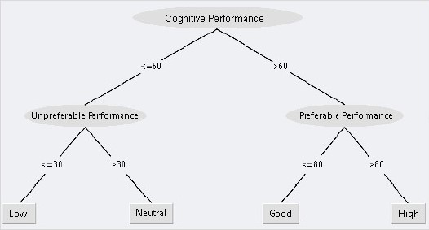
Using the decision tree we can find the cognitive performance levels of each student in every period which can be classified as Good, Neutral or Low. When it is Good then the student can concentrate on studying and when it is Low the student needs rest.
In order to cross validate the decision tree the performance is calculated by 10 times and the accuracy of the experiment is found to be 87% . The error margin of 13% occurs due to other factors in the class affecting the students such as noise and class atmosphere.

Slide 8
Conclusion
Decision tree implementation reveals individual cognitive performance levels.
Slight changes and decreases are noted in cognitive performance with prolonged learning.
Decision tree algorithm yields reliable results with 87% accuracy.
Results are straightforward to interpret, providing clear insights into cognitive performance.
Therefore the classification aids in identifying students in need of mental breaks.
This project shows the potential to optimize teaching strategies for improved student well-being and academic performance.

